Slide 1
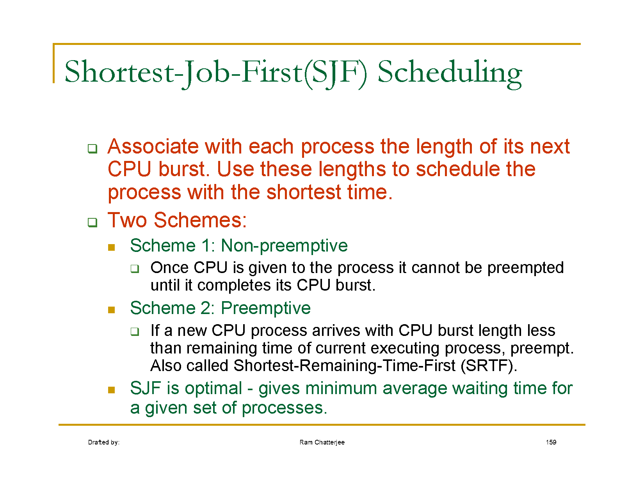

Slide 2
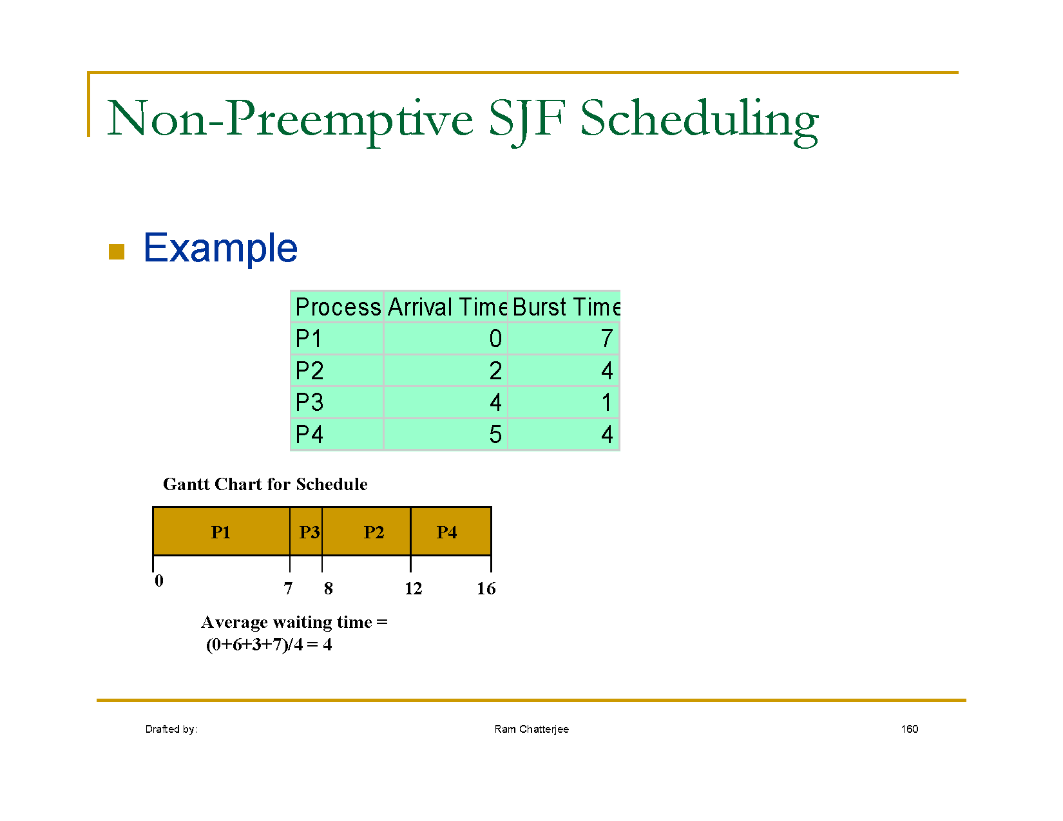

Slide 3
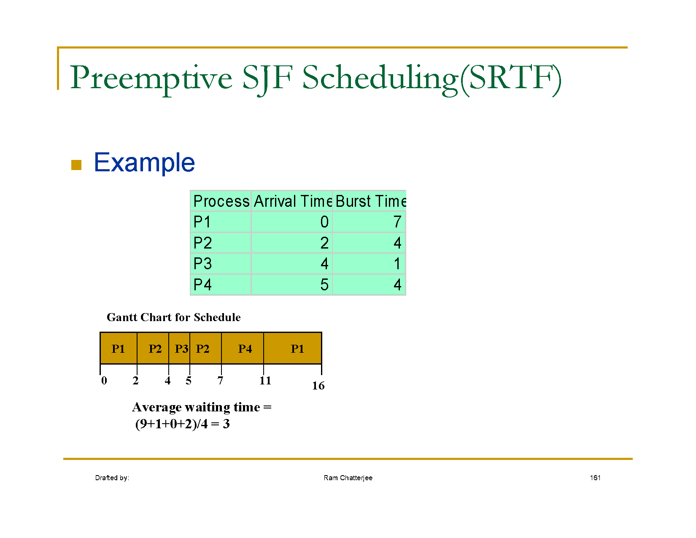

Slide 4
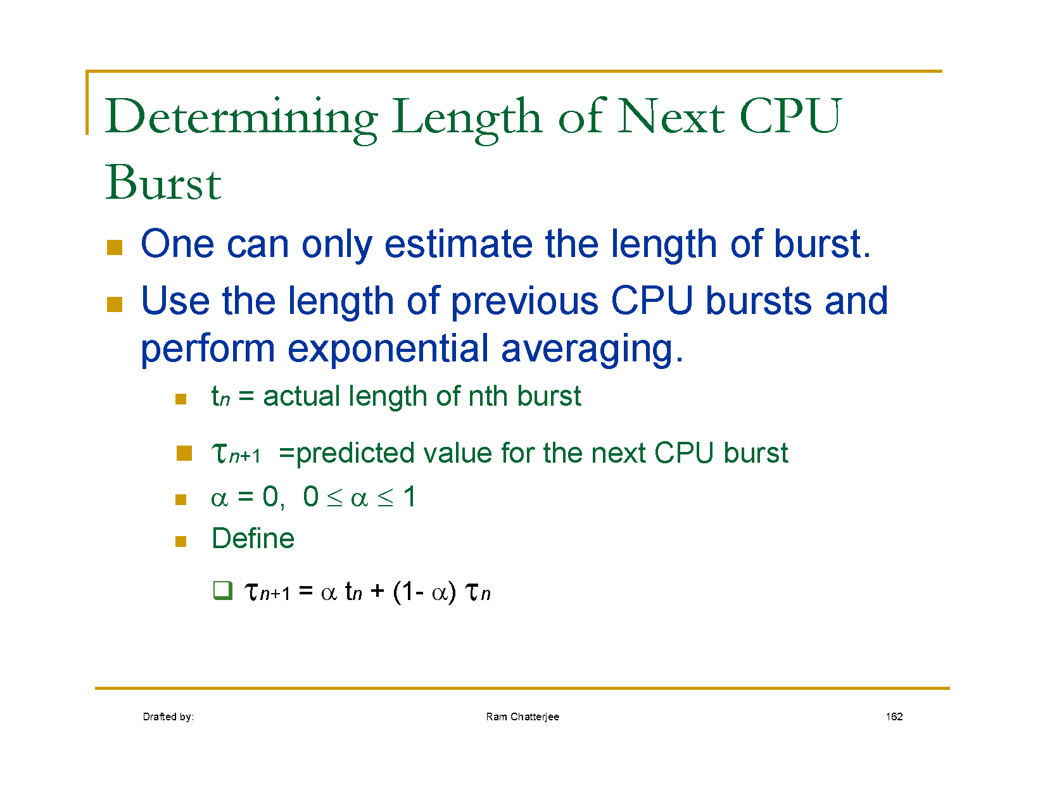

Slide 5
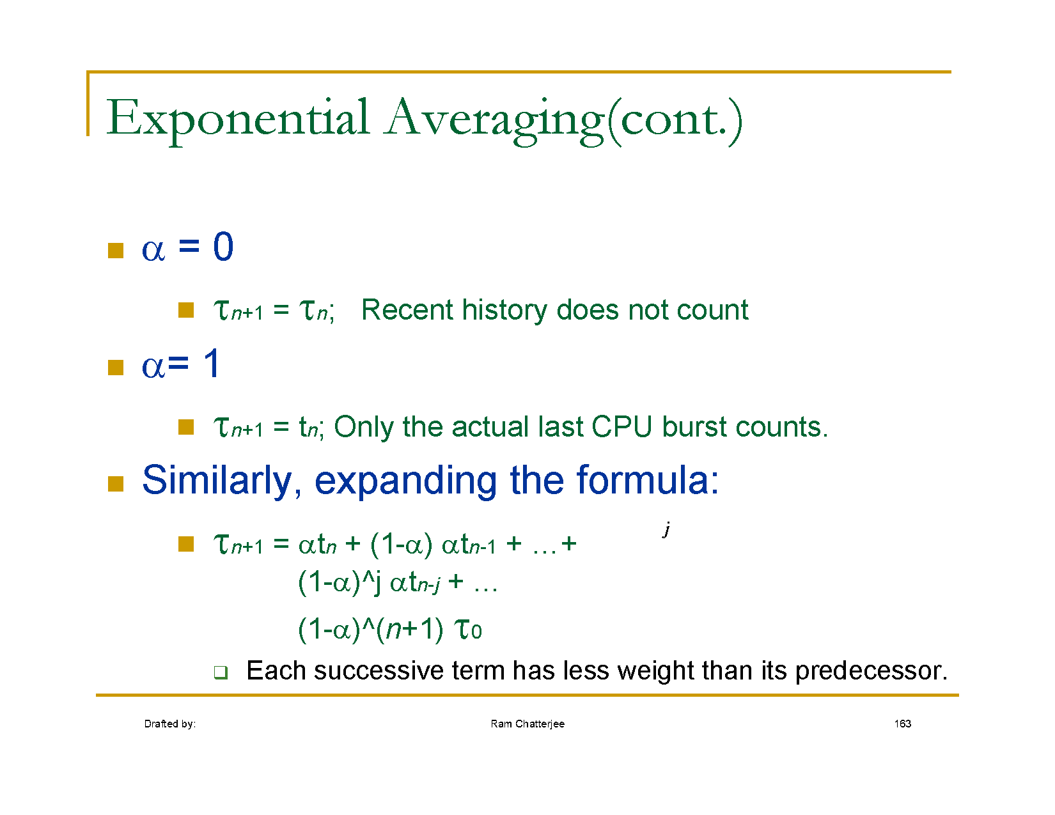

Slide 6
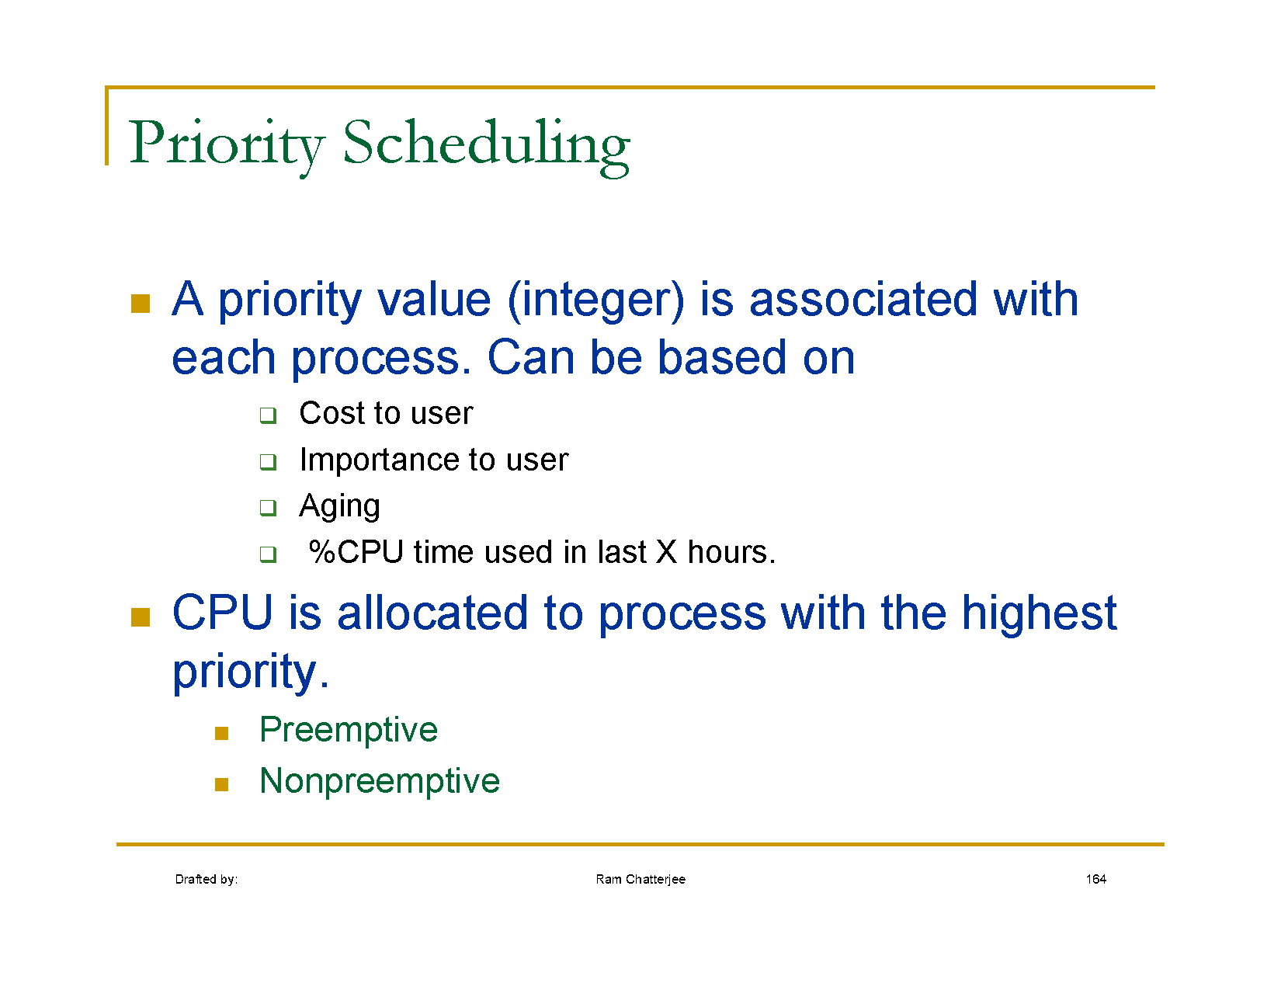

Slide 7
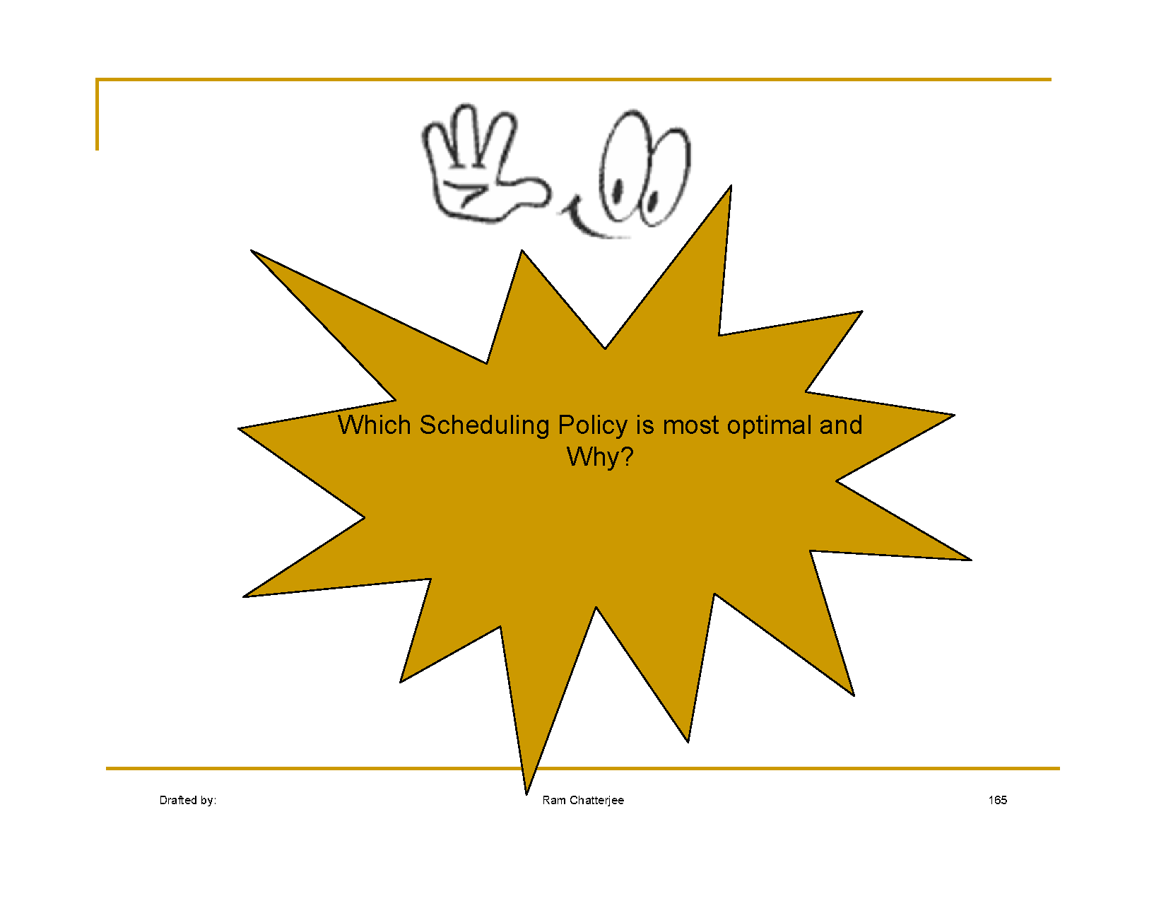

Slide 8
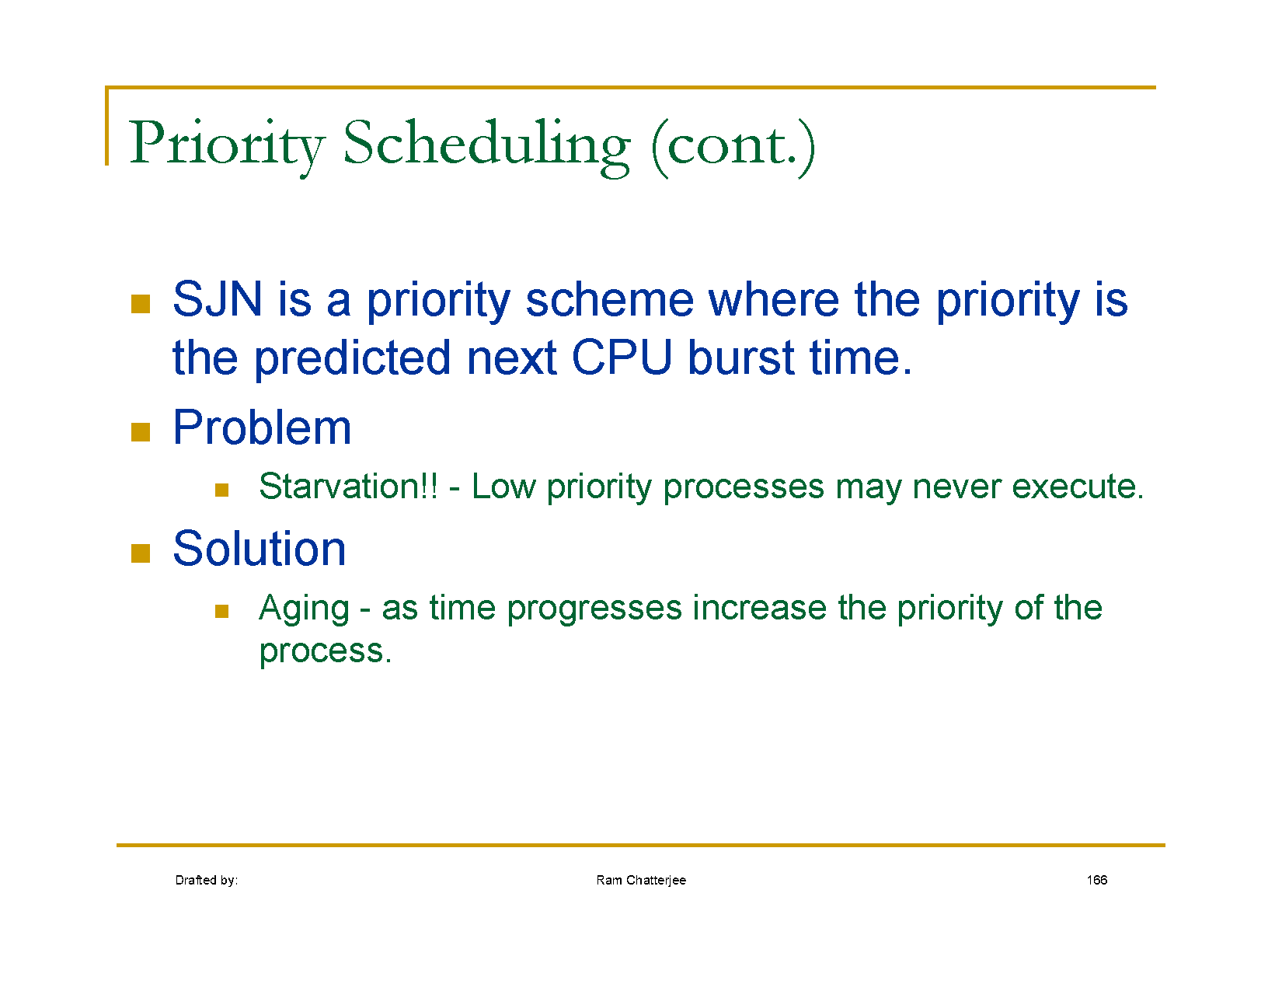

Slide 9
Priority Scheduling
Priority Scheduling always selects the process(es) with the highest priority currently ready to run.
If there is more than one process having the currently highest priority, you need a second scheduling algorithm to choose among these processes.
Non-preemptive Priority Scheduling only selects a new process to run if the running process finished its work or yields (voluntarily) to the scheduler.
Preemptive Priority Scheduling is the same algorithm but if a new process having a higher priority than the currently running process arrives, it gets selected immediately. The new process has not to wait until the currently running process finishes or yields.

Slide 10
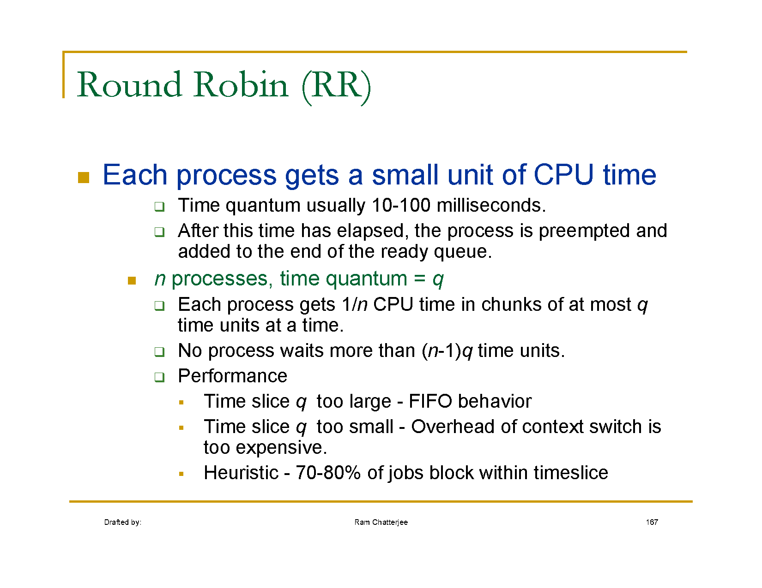

Slide 11
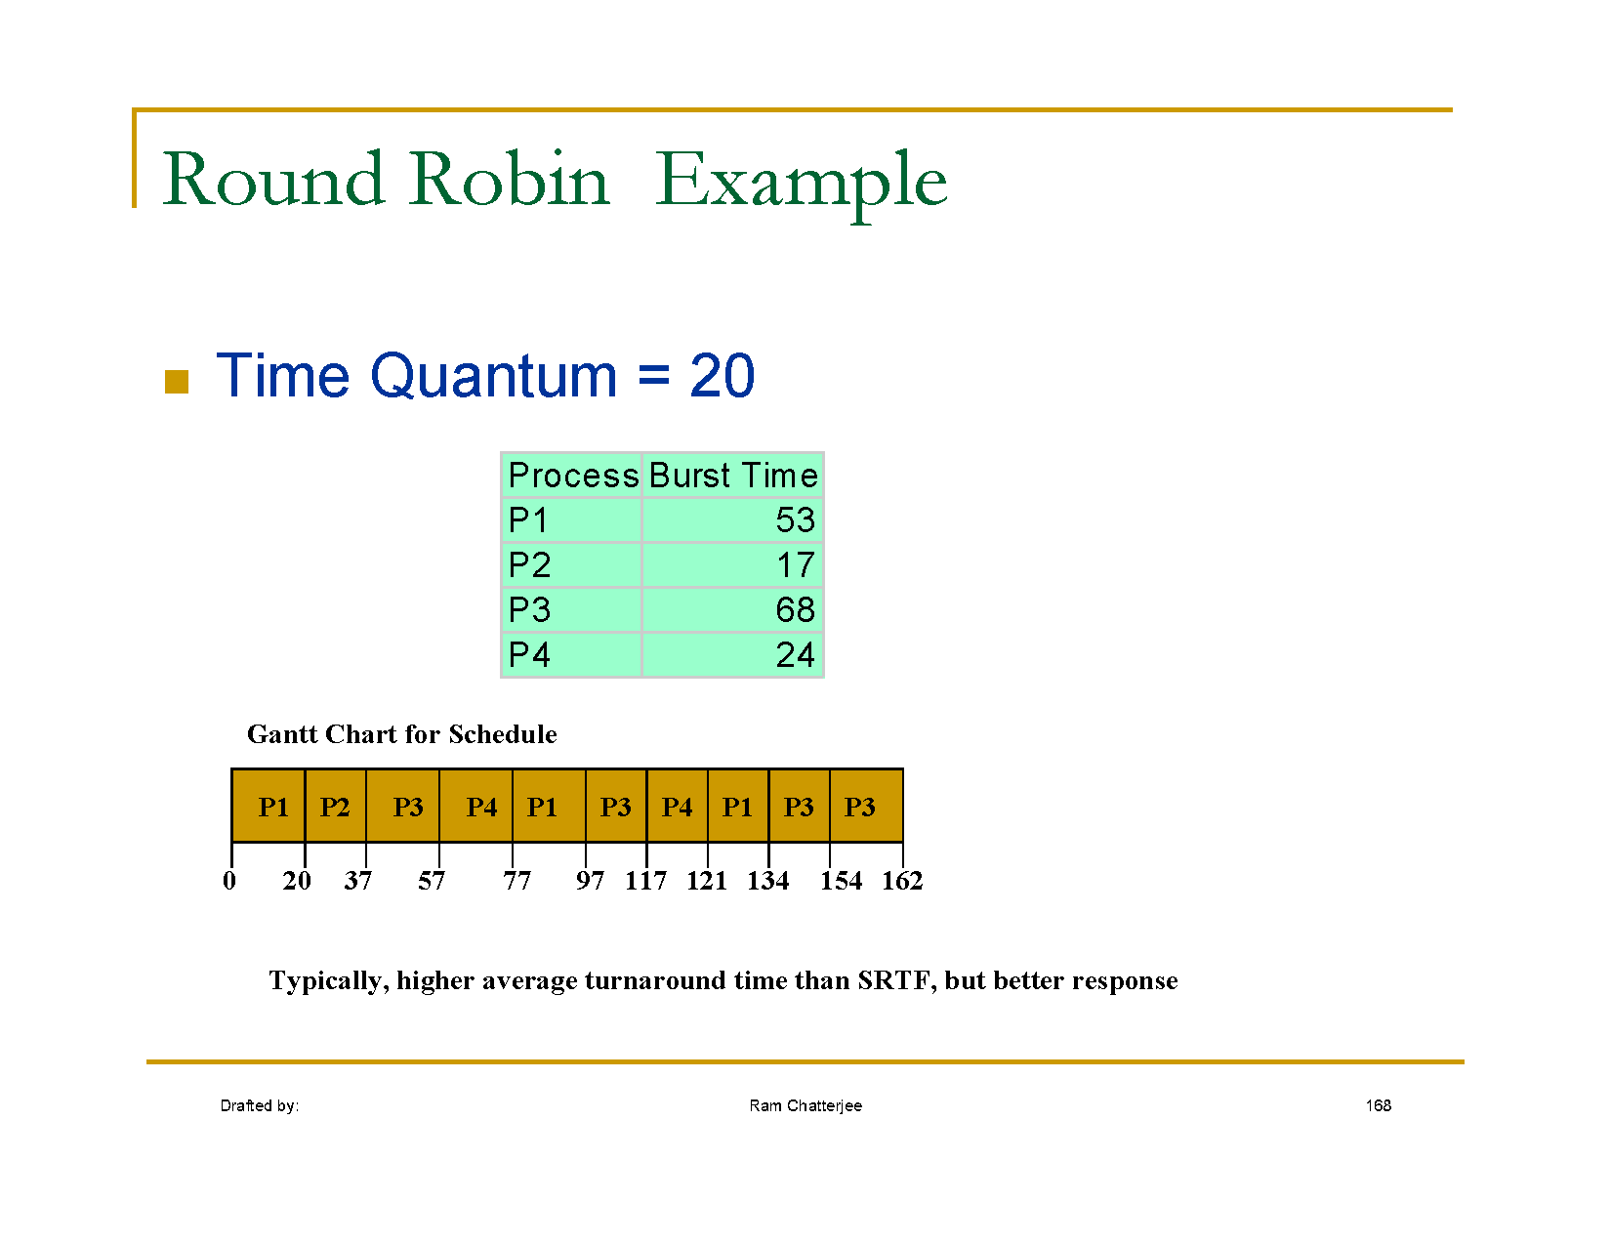
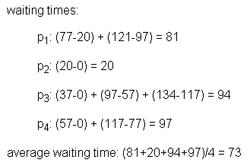

Slide 12
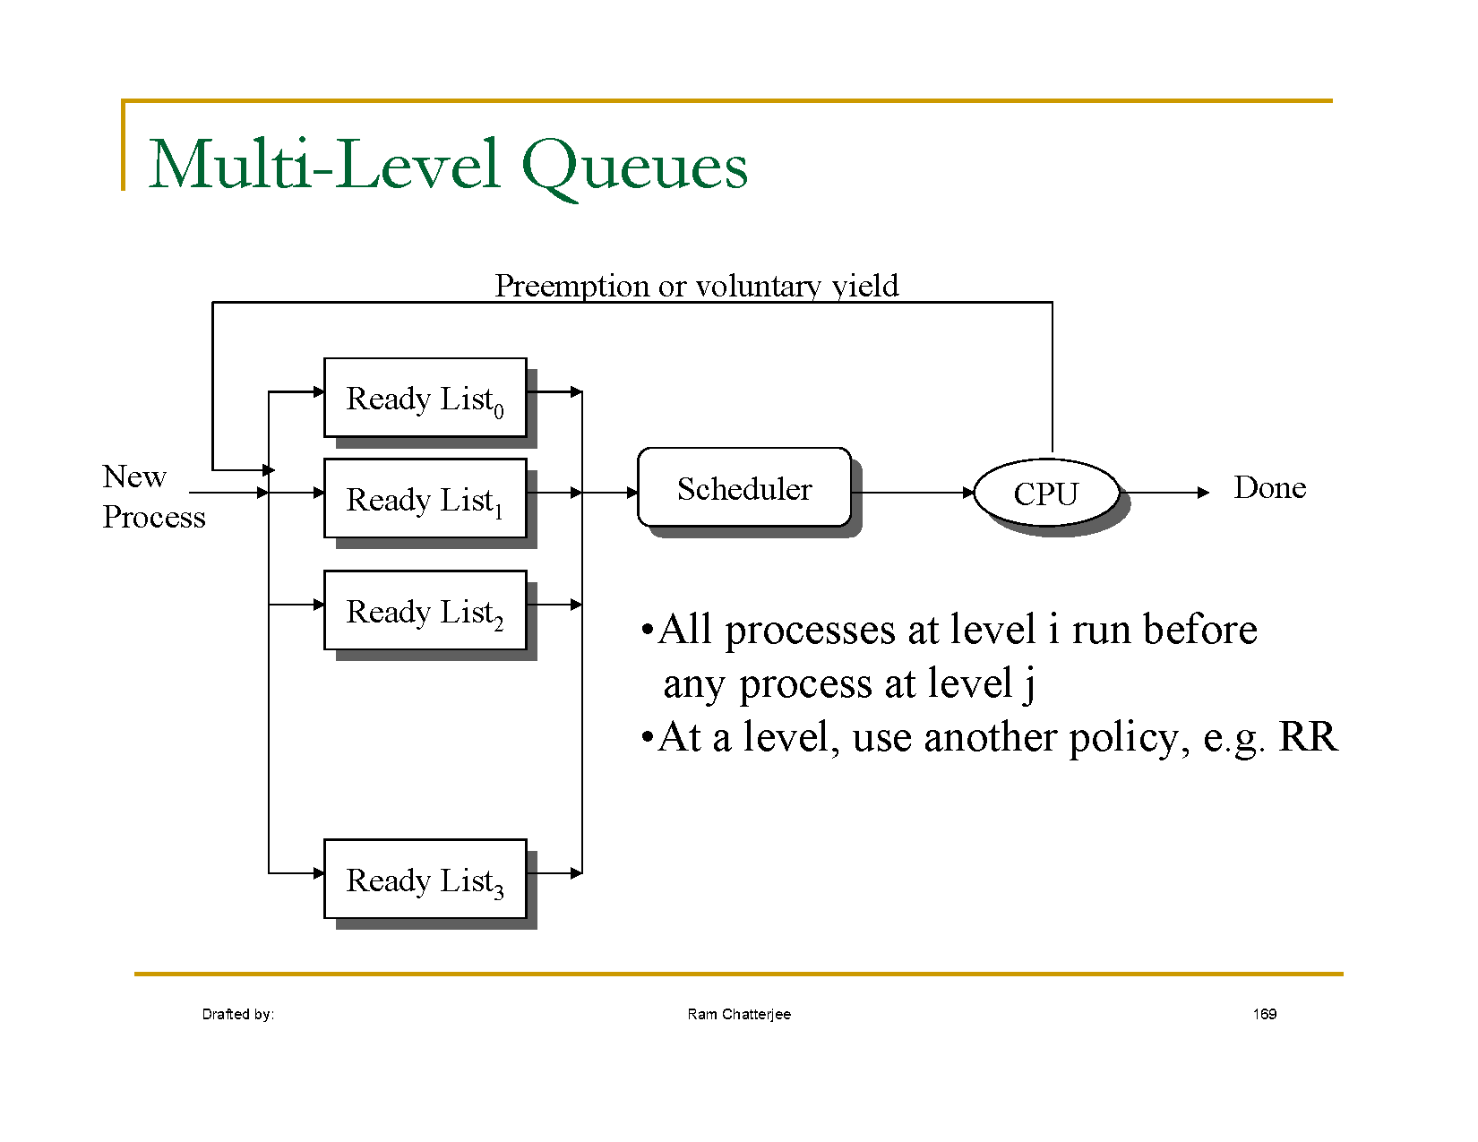

Slide 13
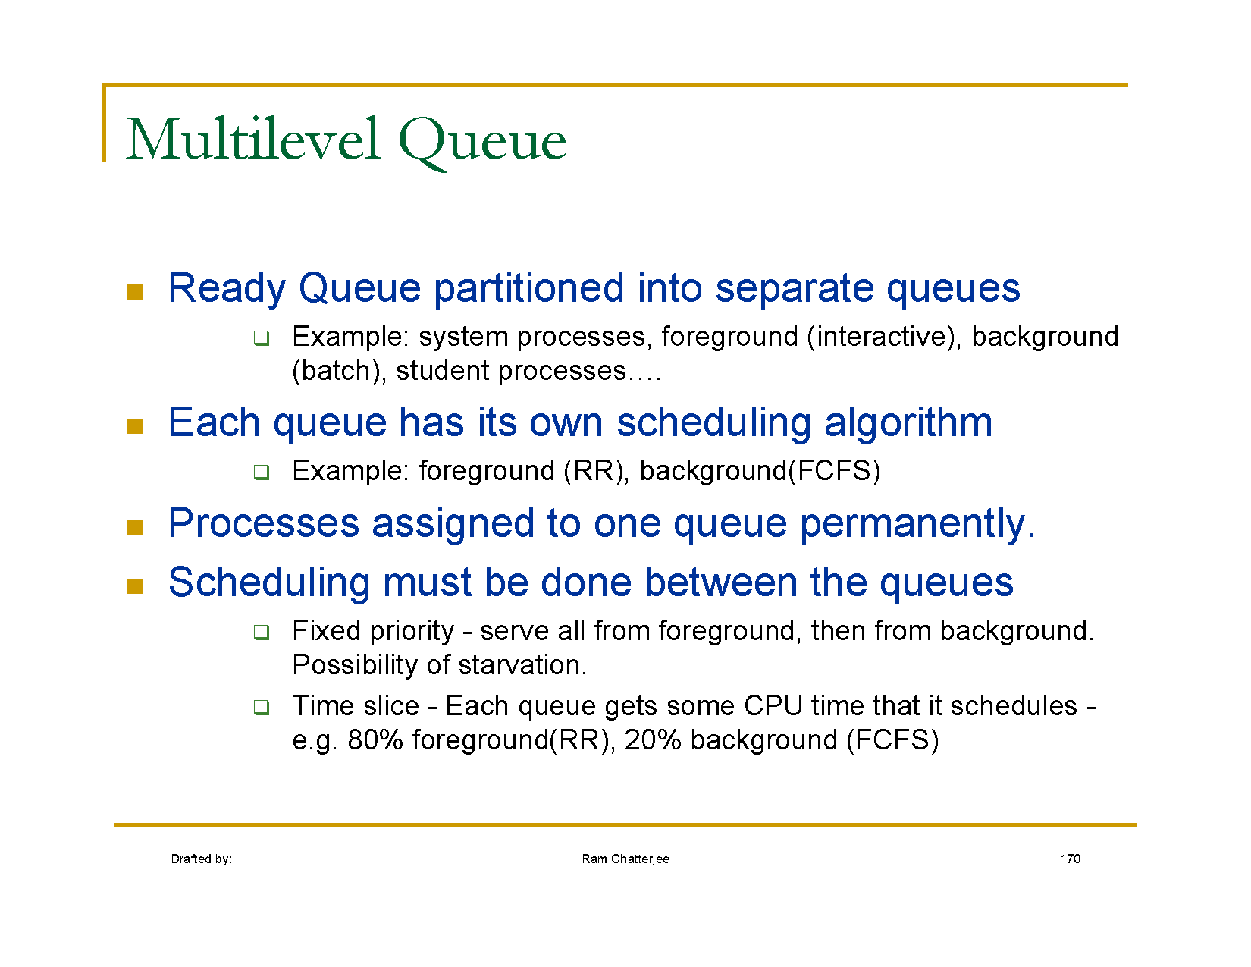

Slide 14
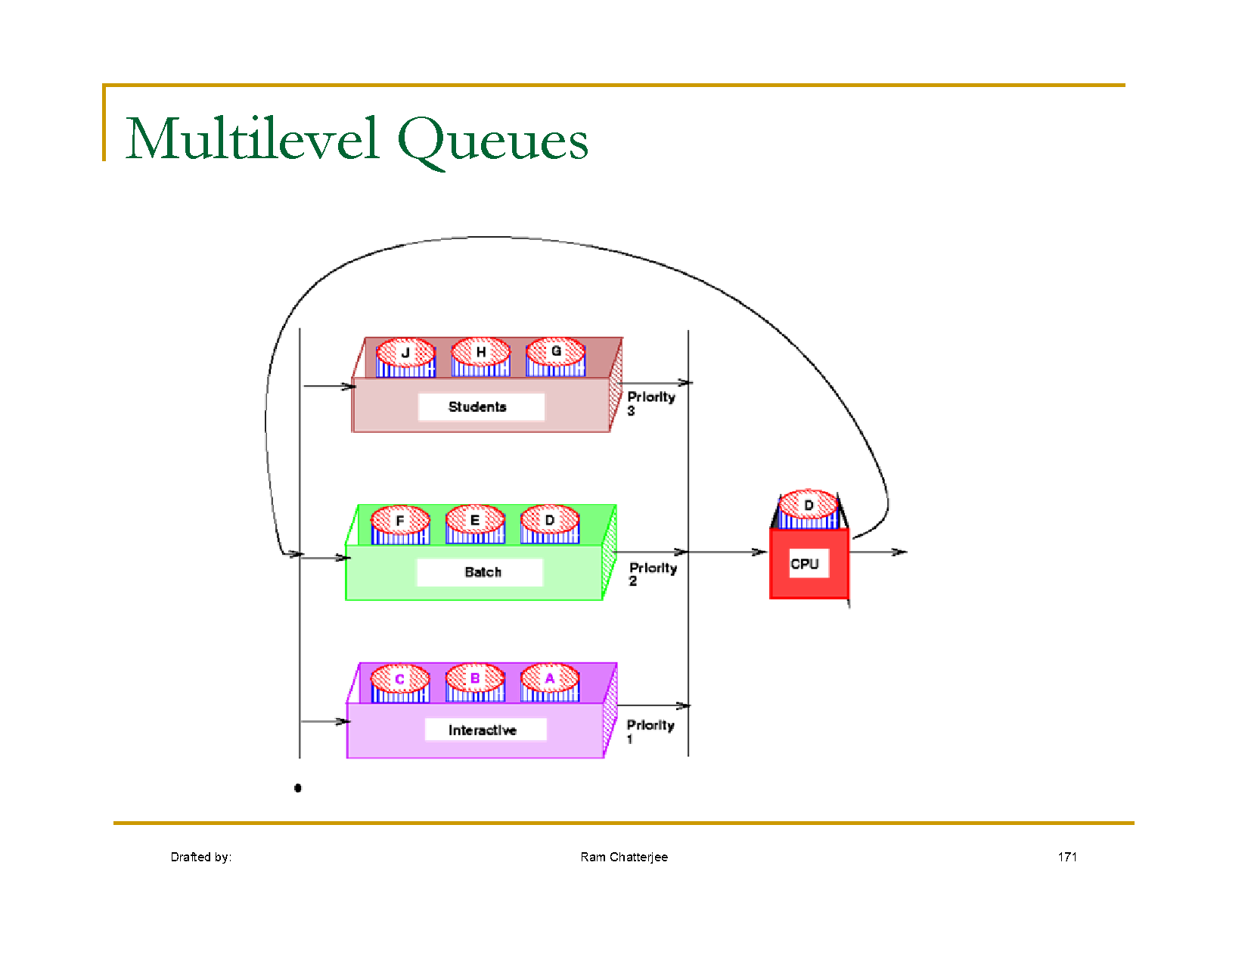

Slide 15
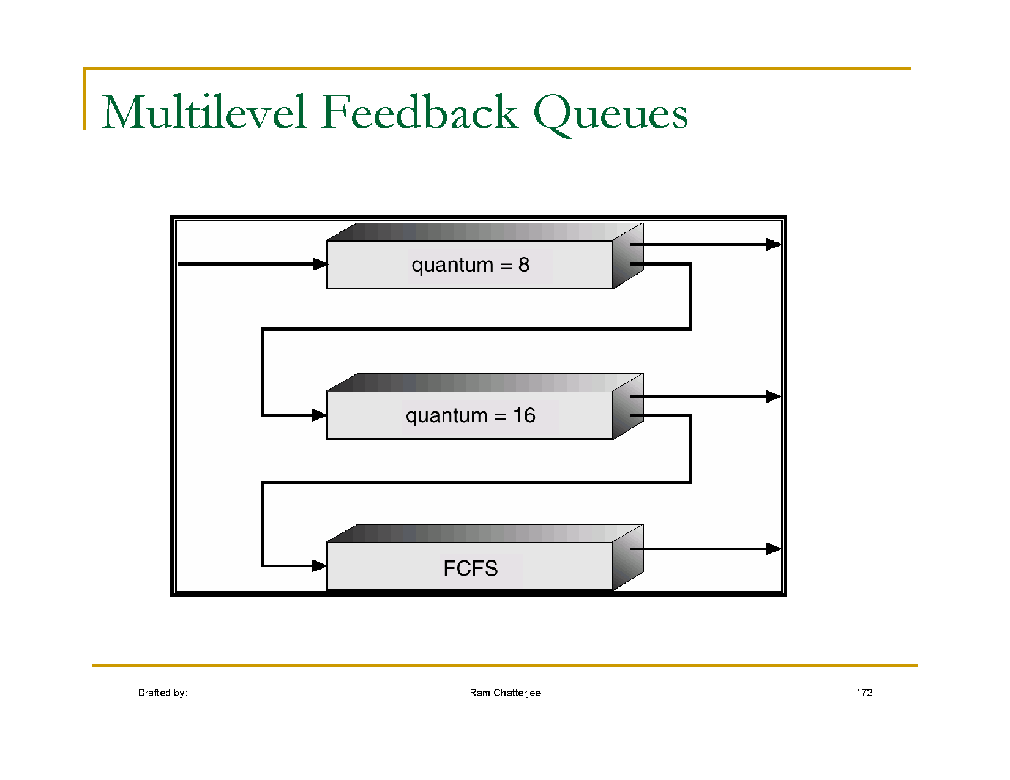

Slide 16
